Slide 1
Welcome! to
Math Night
December 4, 2014
Be Sure To Sign In!

Slide 2
Tonight’s Agenda
Why Investigations?
Textbook Accountability Form (sign and return before you leave)
Break Out sessions (choose 2)
a . Math Strategies – Mr. Potter
b. Try a critical thinking activity – Ms. Rhyne
c. Investigations Games – Mrs. Knight
d. Using a number line-Mrs. Favaloro
e. Games to do at home – Mrs. Bombassaro

Slide 3
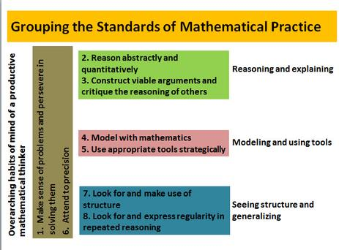
Why Investigations?
Math Standards - The Big E (for Excellence)

Slide 4

Why Investigations?
Not the way we were taught!
The program focuses on:
Numbers and Operations: Students learn how to do addition, subtraction, division and multiplication and understand the relationship the operations have with one another. Students also learn about how our number system works.
Problem Solving Strategies- Students learn strategies, not just the vertical equation.
By using their “toolboxes of strategies” students solve math problems in ways that make
sense to them. They are provided with MORE THAN ONE WAY!
PROBLEM SOLVING STRATEGIES:
Refer to the parent letter and student handbook for explicit details.
1. Number Line
2. Adding a number in parts
3. Adding a number by place
4. Adding numbers by changing them to landmark numbers.
GAMES: Games provide opportunities for students to practice important
mathematical concepts and skills This interaction also further develops and deepens students’
mathematical understanding and reasoning.
DISCUSSION: Students also spend time discussing problems in depth (whole class and small group). During the discussion students share their reasoning and justify their solutions with each other.
WRITING: Students also provide written responses explaining their work. This provides additional practice in cross curricular objectives of writing to communicate.

Slide 5
Student And Teacher Roles
Student
Teacher
Students are the critical pieces of the puzzle. Where they are with an idea, and how they approach a problem, affects the math strategies that will be used. The different strategies allow students some “choice” in how they show their work and solve the problem. It respects their own ‘learning styles”.
Teachers facilitate the creation of an environment in which the practices can flourish. Sometimes they purposefully focus on one particular strategy. Other times, they capitalize on an opportunity that arises in the classroom. Teachers must be able to see and recognize the various Math Practices, and they must be “mathematically proficient.”

Slide 6
Inside the Investigation Classroom
Let’s take a peak inside a typical classroom:
http://www.pearsonschool.com/index.cfm?Locator=PSZaEo
While you are viewing the video look for those key ideas.

Slide 7
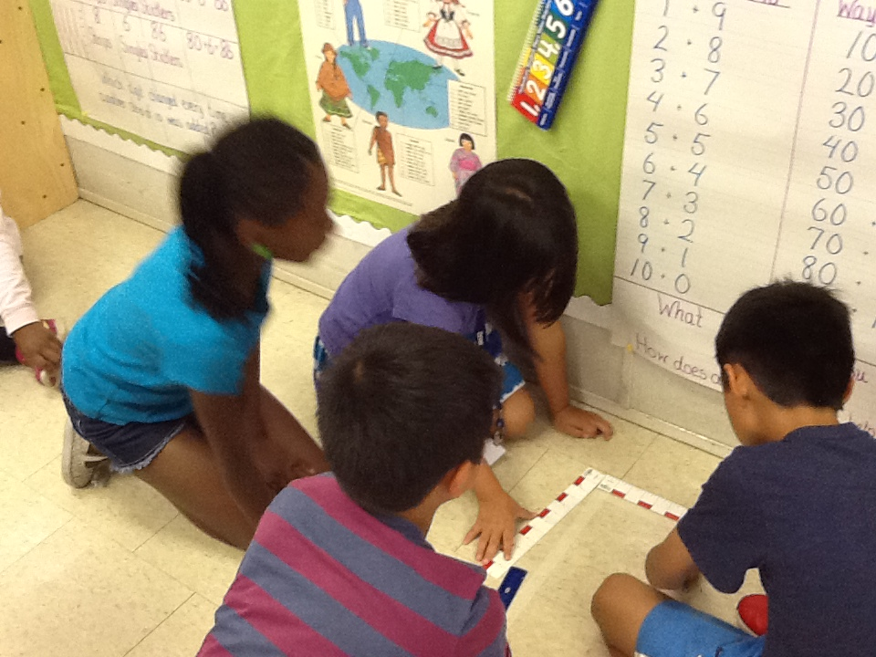
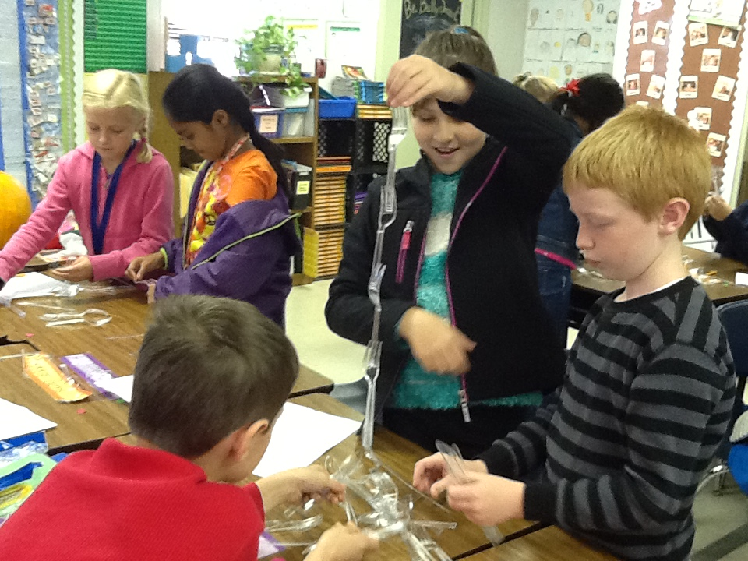
INSIDE OUR MATH CLASSROOMS
Make Sense of problems and Persevere in solving them

Slide 8
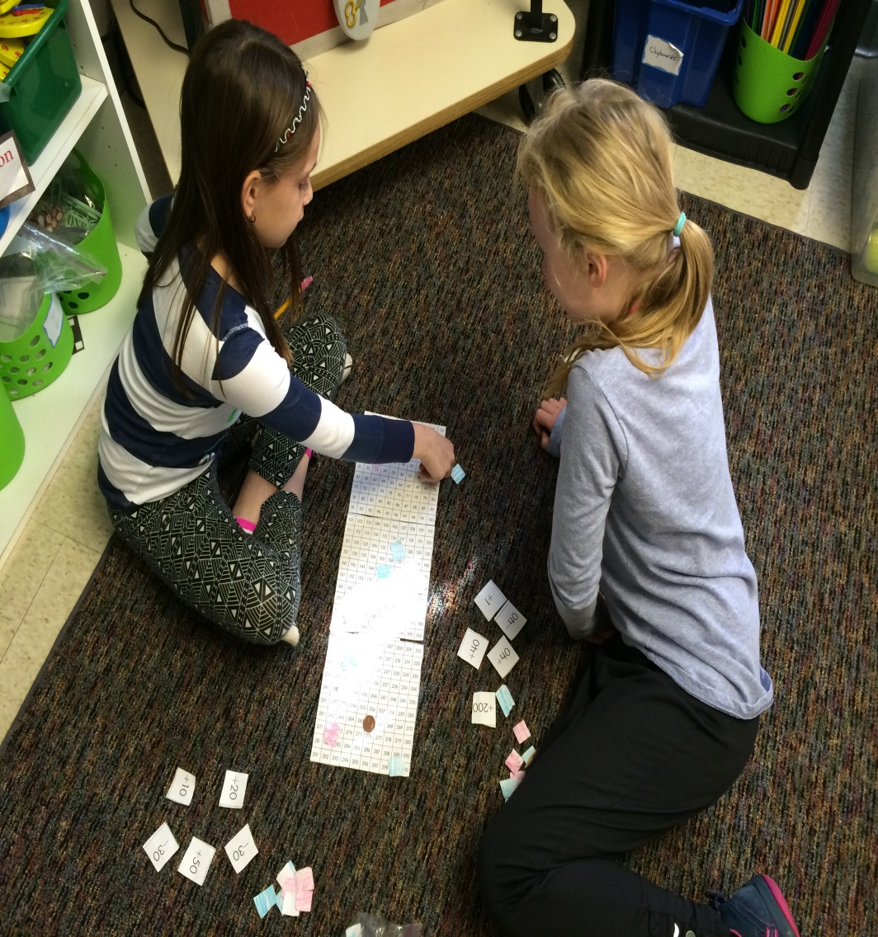
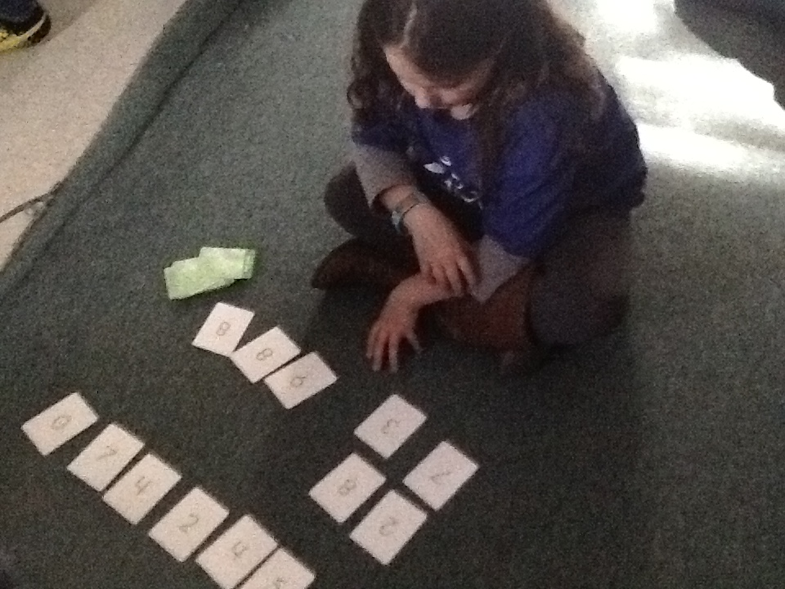
Practicing Skills Through Games

Slide 9
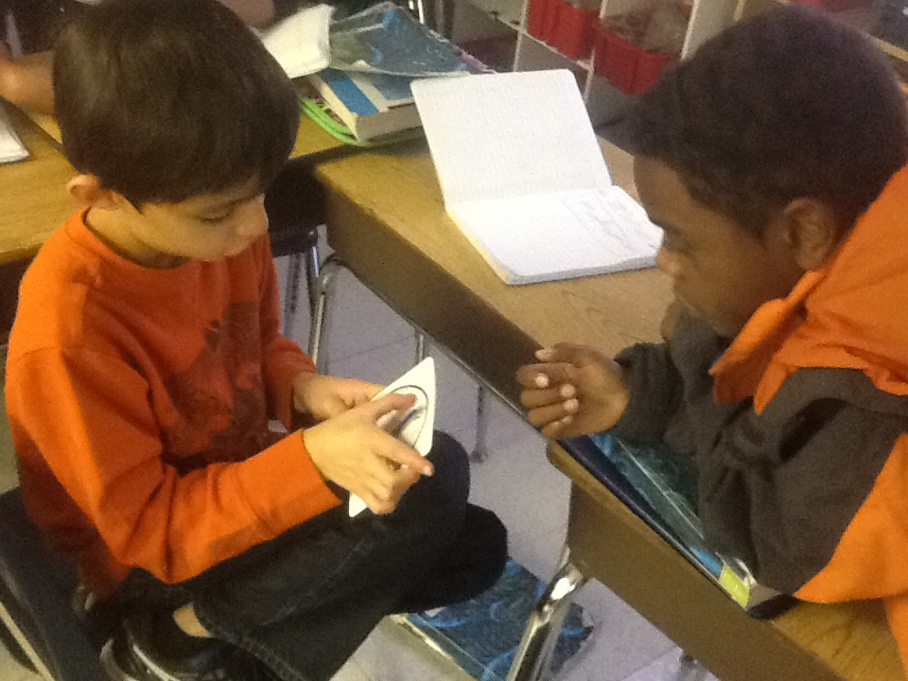
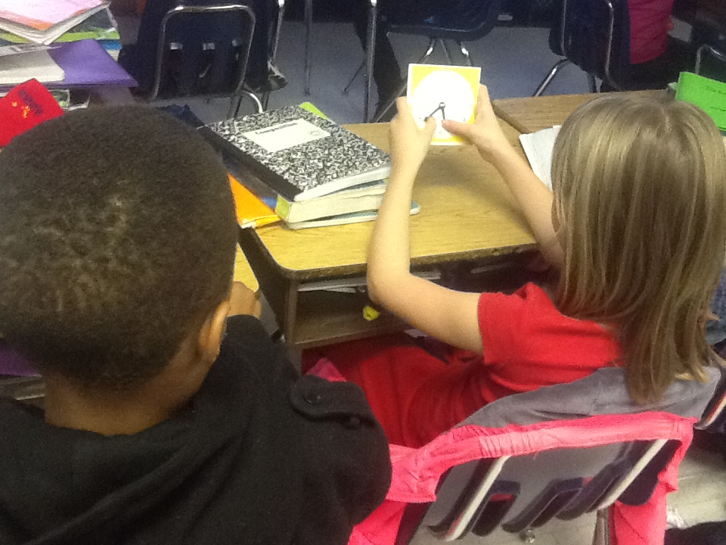
Modeling And Using Tools

Slide 10
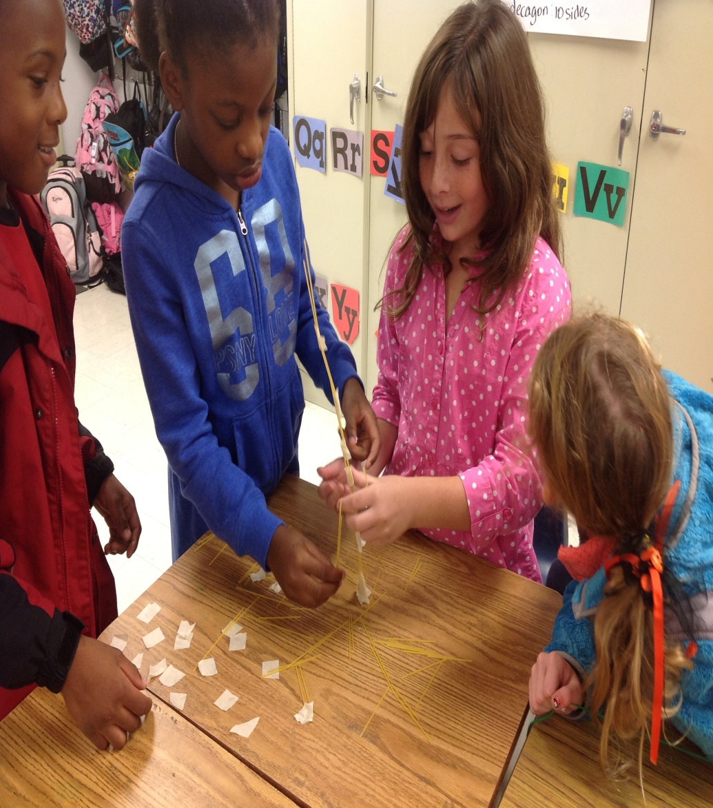
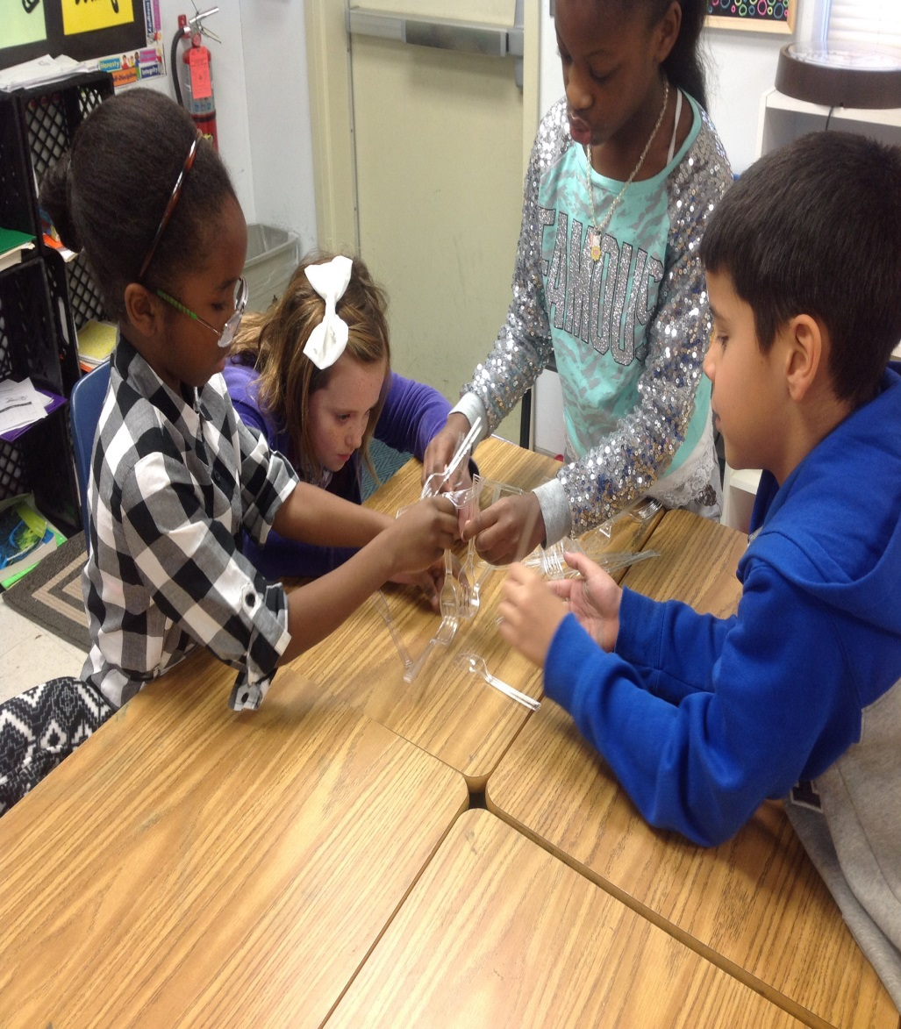
Critical Thinking Activities
Reasoning Abstractly and Quantitatively

Slide 11
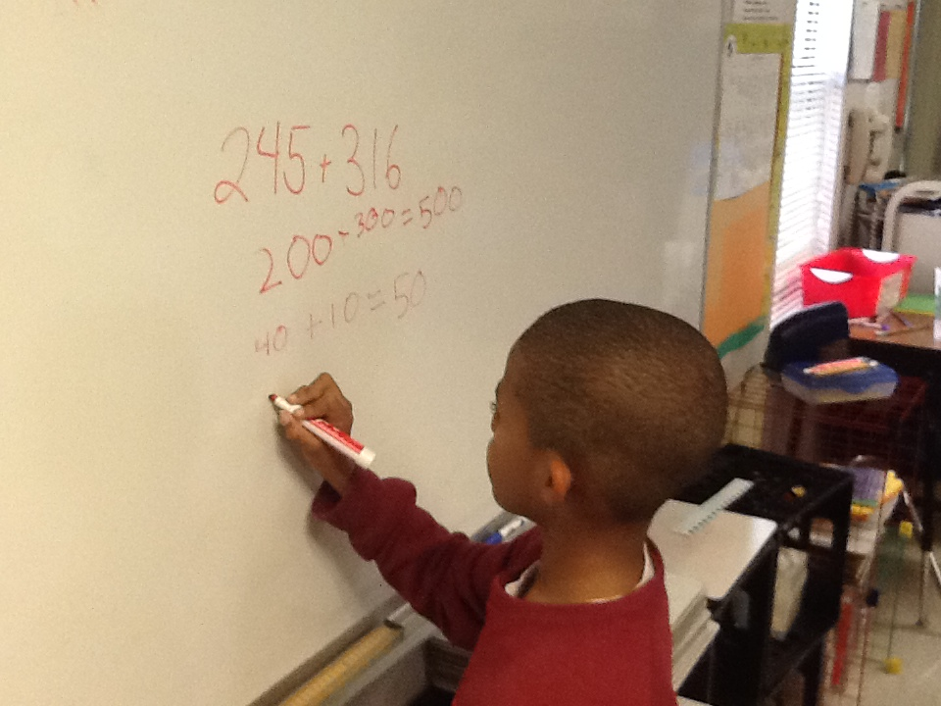
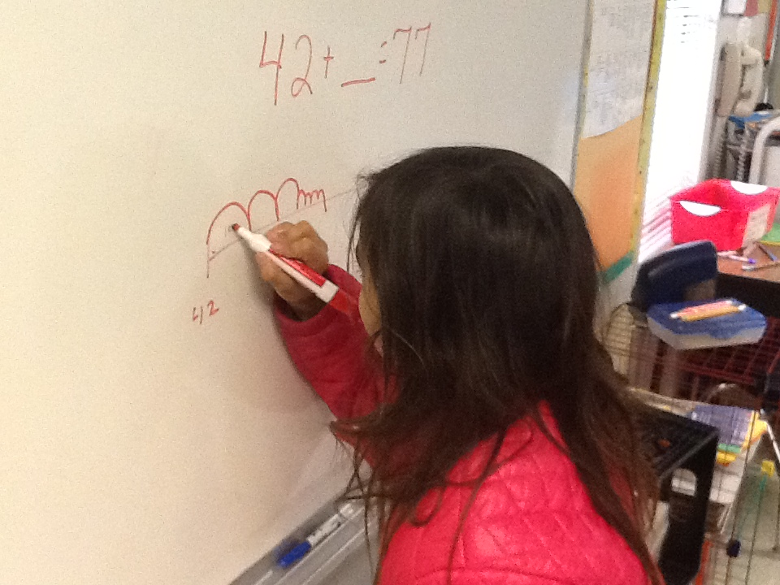
Modeling With Mathematics
Attending to Precision

Slide 12
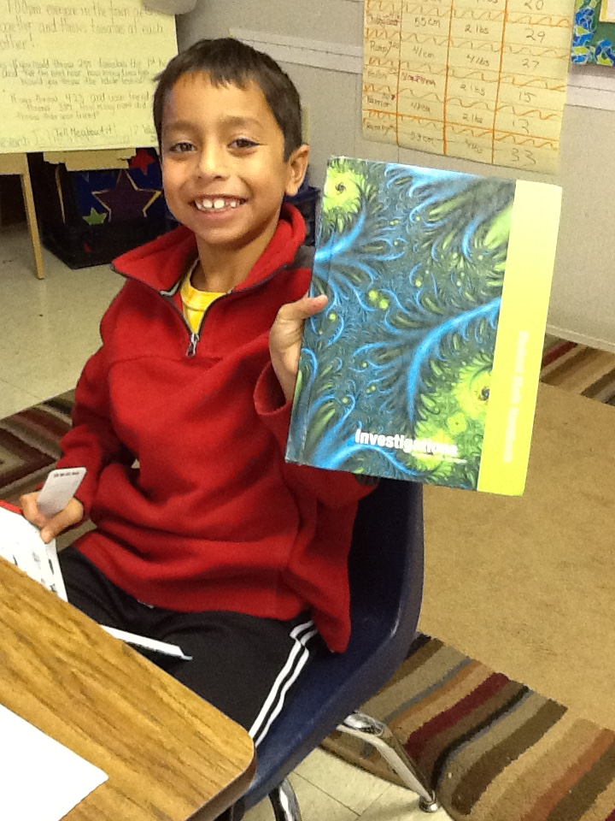
Have you seen this Handbook?
Each Child has their own Math Handbook!
Be sure to sign the textbook accountability form and return to your child’s teacher.
This book helps to explain all of the strategies taught in our classrooms.
It will help your child explain the math to you and it will help them to do their nightly homework.
Students should bring the handbook home to help support on going learning.

Slide 13

Break Out learning Stations
This is just a sampling of the many things we are doing in math! PLEASE FEEL FREE TO BROWSE THROUGH EACH OF THE STATIONS! We encourage you to visit all of them! | Mr. Potter – Math Strategies Break a number in parts Break a number by place Use a landmark number
Mrs. Bombassaro- Games to do at home Dice Games & Card Games | Ms. Rhyne – Critical Thinking Activities Exploring Tangrams Popsicle Stick Challenge Logic Links Marcy Cook Tiling
Mrs. Knight – Investigation Games Capture on 300 & Collect $2.00 | Mrs. Favaloro – Number line Learn how to use it to solve for addition, subtraction, multiplying and dividing. You can also use it for fractions and elapsed time!

